Slide 1
Sovos Accordance
International VAT - Presentation
Caroline Jouin
Enterprise Account Manager

Slide 2
Our Offering VAT Compliance and Consulting
Our comprehensive EU VAT support enables our clients to trade with ease across the EU through:
Pragmatic VAT advice and VAT compliance services
Centralised point of contact for VAT obligations (VAT Registrations, VAT Returns, Intrastat, SII, SAF-T, etc) across all 27 EU member states and beyond.
Expert Senior VAT Consultant dedicated to each client
Proactive account management structure
VAT technology solution integrated in the heart of our offering to meet increased compliance demands from Tax Authorities
Over 30 languages spoken in-house
Our clients find in us a trusted advisor who is on hand to reassure, assist and ultimately facilitate effective cross-border trade in an ever-changing economic and political landscape.

Slide 3
Latest Articles, Press Releases & Blog
Articles
Netherlands | Covid-19 – Emergency VAT payment deferral extended
France | No Fiscal Representative requirement post-Brexit
Ireland | Tax authorities can order Fiscal Representative requirement
Press
Bloomberg Tax | Brexit and Fiscal Representation
Bloomberg Tax | Postponed Import VAT Accounting
Blog
How to Prepare For Brexit Now | Customs and VAT FAQ

Slide 4
Some of our clients…

Slide 5
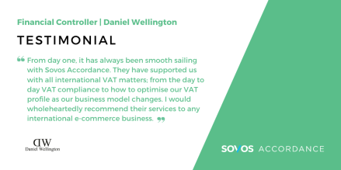
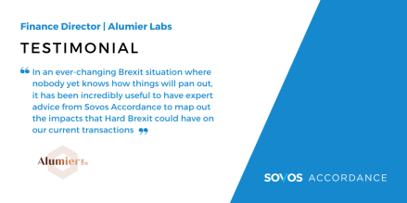
WHAT OUR CLIENTS SAY

Slide 6
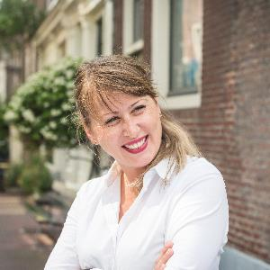
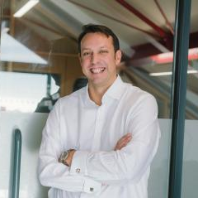
Your team
By integrating bespoke software into the heart of our offering, Accordance is future-proofing compliance for clients. SOVOS software complements the acknowledged value of our expert holistic approach to navigating European VAT diversity and complexity.
CAROLINE JOUIN | ENTERPRISE ACCOUNT MANAGER
Partnership Management|VAT Project B2B|Proactive account management|Effective communication|Coordinates service delivery|On hand for queries
ALEX SMITH | VAT DIRECTOR
Continuous strategic conversation to meet commercial goals & VAT obligations
Provide support in meeting legislative changes
On hand for ad-hoc queries

Slide 7
Caroline Jouin
Enterprise Account Manager
Tel: +44 (0) 333 522 0834
Email: caroline.jouin@sovos.com
www.accordancevat.com

